Slide 1

Automating Nucleus Detection in Microscopy Images
2018 Data science bowl
Puneet Vashisht
Abhishek Gupta
Palvika
Ankita Jha

Slide 2
Agenda
1
Objective & Motivation
Data description
Exploratory Data Analysis (Stage1 & Stage2)
Our Approach (Pre and Post Processing)
UNet Implementation
Mask RCNN Implementation
Top Rankers’ Solution
Conclusion
Data Science Lab 2018

Slide 3
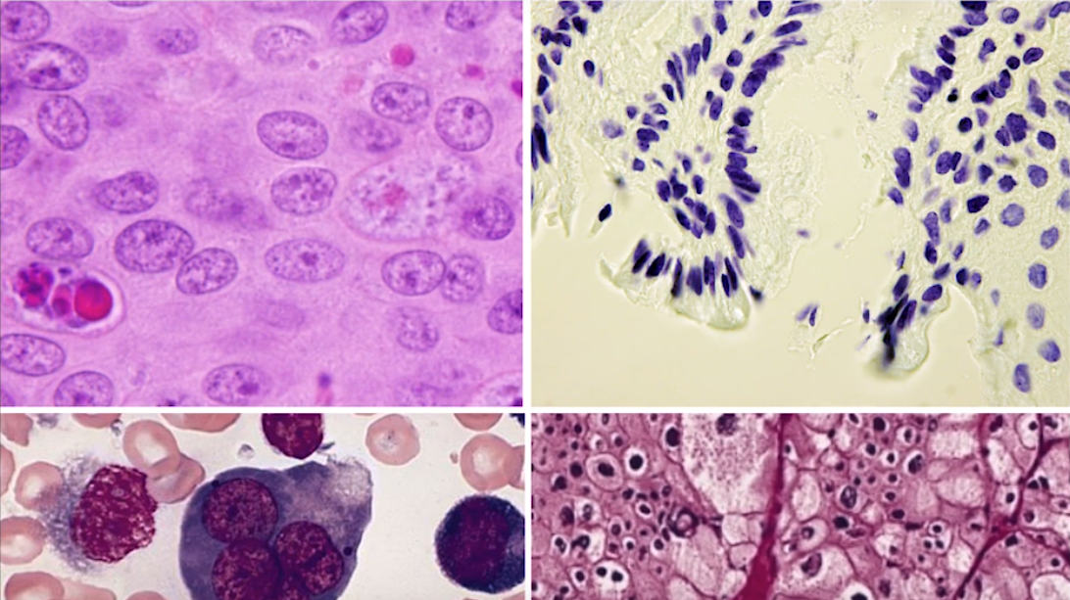
Objective & Motivation
1
Our objective is to create a robust deep learning model that can identify a range of nuclei from microscopy images taken across varied conditions.
Quick and correct identification of a cell’s nucleus enhances drug development and testing and advances medical treatment.
Challenges
Classical image processing algorithms work well when the nucleus are round and not too crowded.
The challenge is to build a robust model that can identify nuclei regardless of the stain type, the species, the cell type, the microscope resolution used.
Data Science Lab 2018
Notes:
New drug development involves adding particular chemicals to batches of cells to see if there is a positive change. The first step here is identifying the nucleus of the cell, from where the software can easily measure various properties of the cell to discern a diseased state.
however, sometimes nuclei can have very unusual shapes and sometimes they can be difficult to distinguish.
The biologist then needs to look at thousand of images by eye in order to understand the state of the cell.

Slide 4
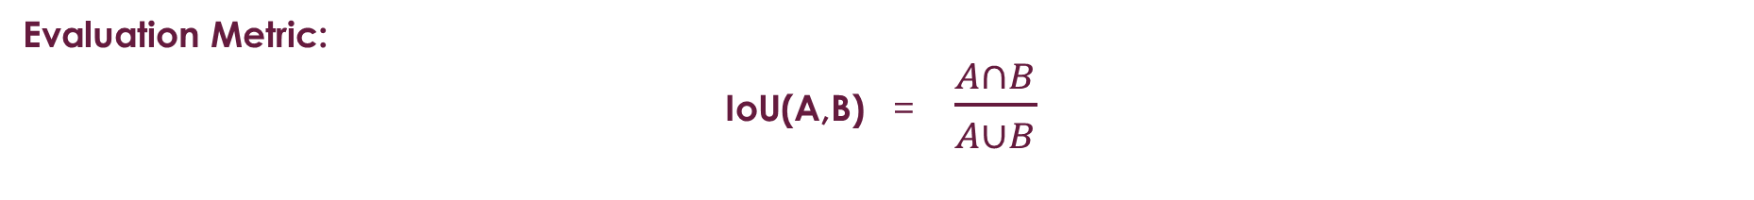
Data Description
1
The dataset contains a large number of segmented nuclei images. The images were acquired under a variety of conditions and vary in the cell type, magnification, and imaging modality (brightfield vs. fluorescence).
For the training set, a set of masks is given for each image, which identifies the nucleus positions.
670 : Number of images in training set
65 : Number of images in test set
Evaluation Metric:
IoU(A,B) = $\frac{A∩B}{A∪B}$
The metric sweeps over a range of IoU thresholds in steps of 0.05.
For example, at a threshold of 0.5, a predicted object is considered a "hit" if its intersection over union with a ground truth object is greater than 0.5.
Submission Format:
Run-length encoding on the pixel values: pairs of values that contain a start position and a run length.
Data Science Lab 2018

Slide 5
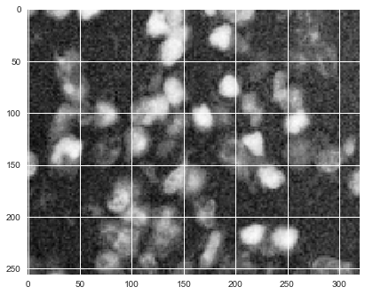
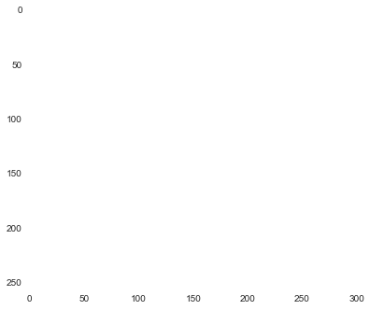
Stage 1 EDA: Images
1
4th channel given for all images is empty
Data Science Lab 2018

Slide 6
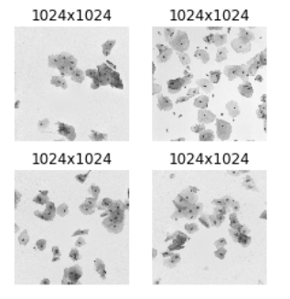
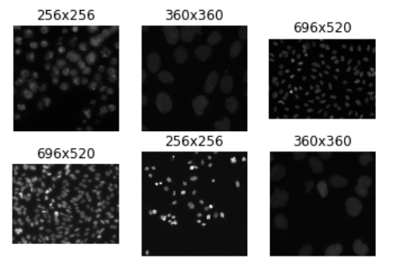
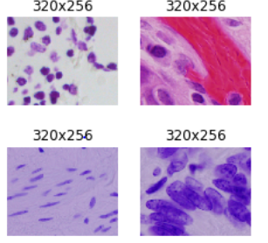
Stage 1 EDA: Images
1
Three types of images (based on the type of microscope used)
Fluorescent (81.5%)
Histological (16.1%)
Bright-field (2.4%)
Data Science Lab 2018

Slide 7
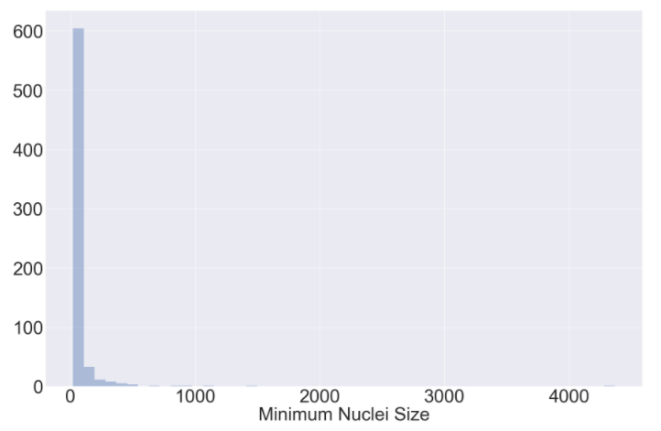
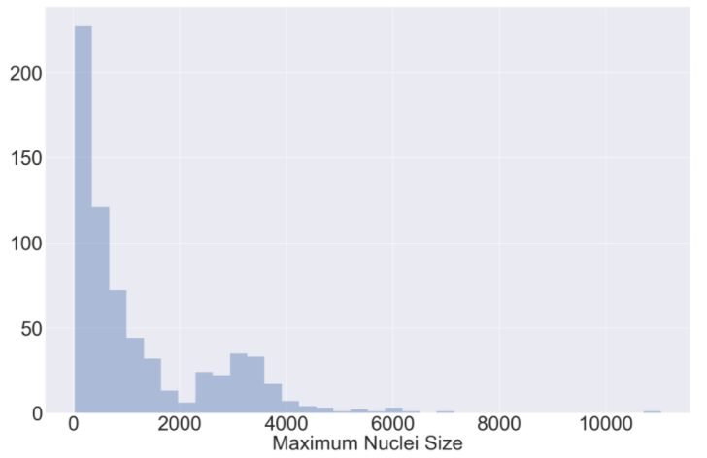
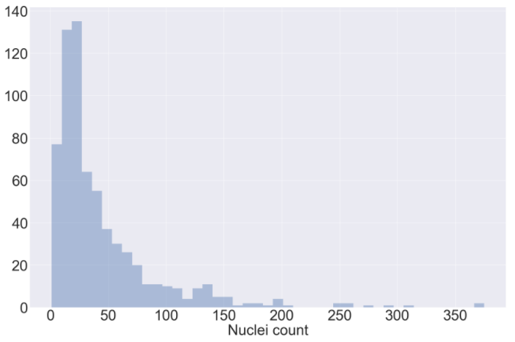
Exploratory Data Analysis: Nuclei
1
4367px
11037px
26px
21px
375
1
Data Science Lab 2018

Slide 8
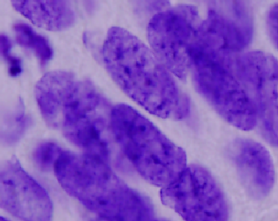
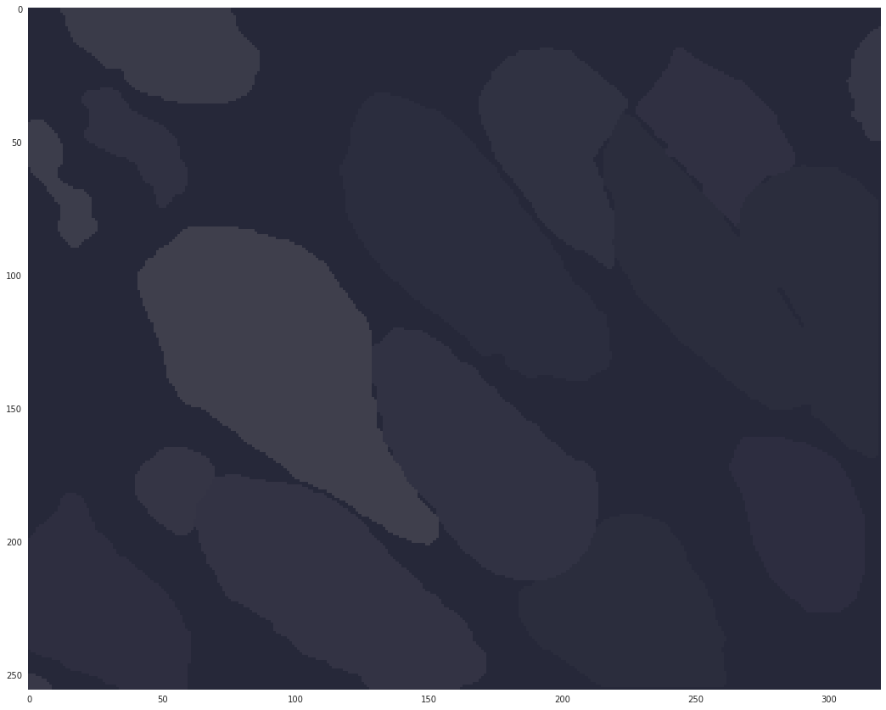
Exploratory Data Analysis: Nuclei Overlap
1
Data Science Lab 2018

Slide 9
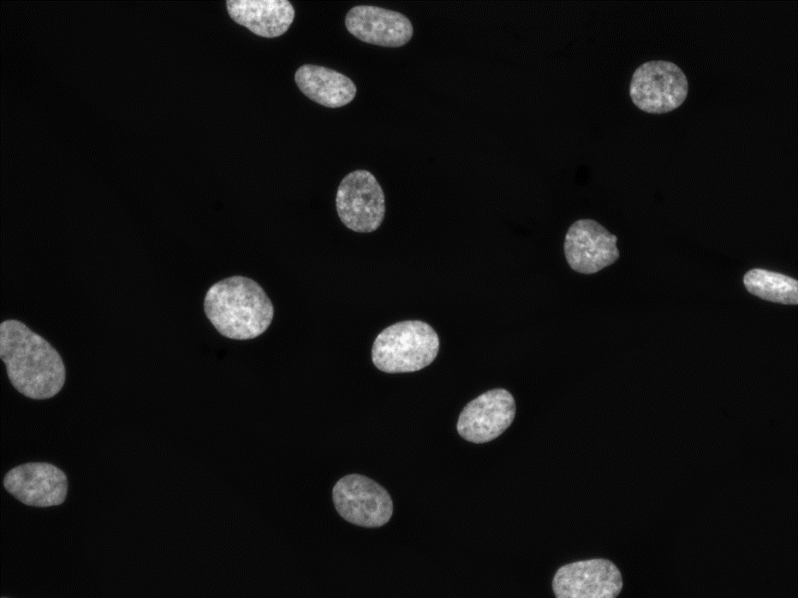
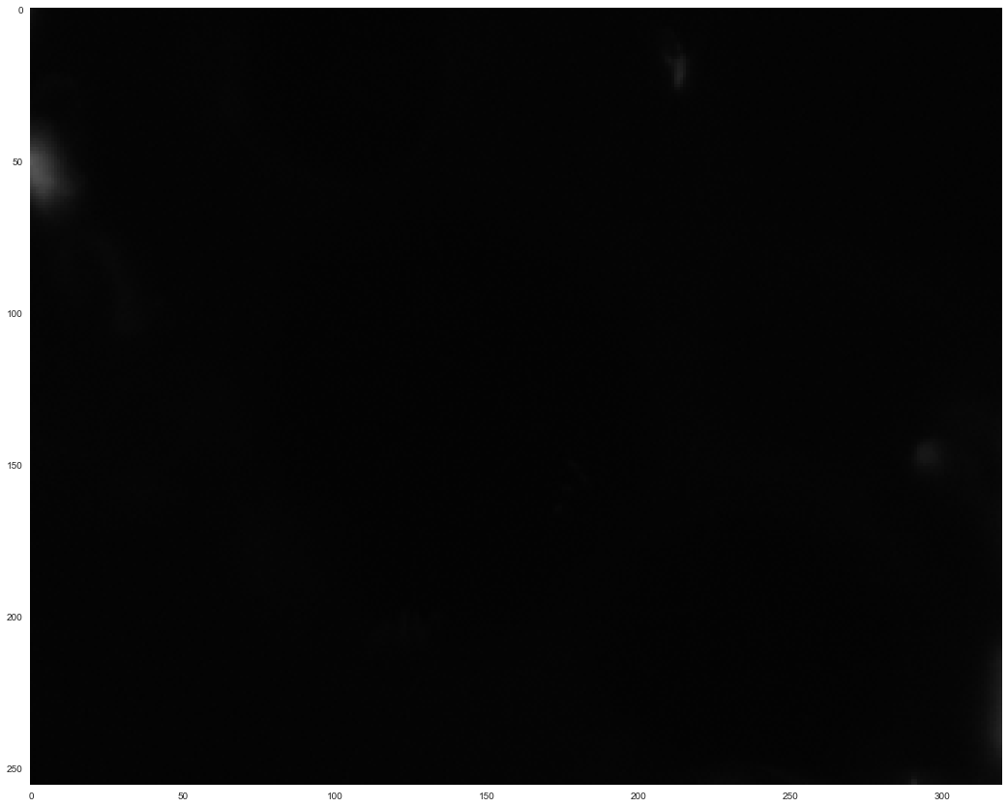
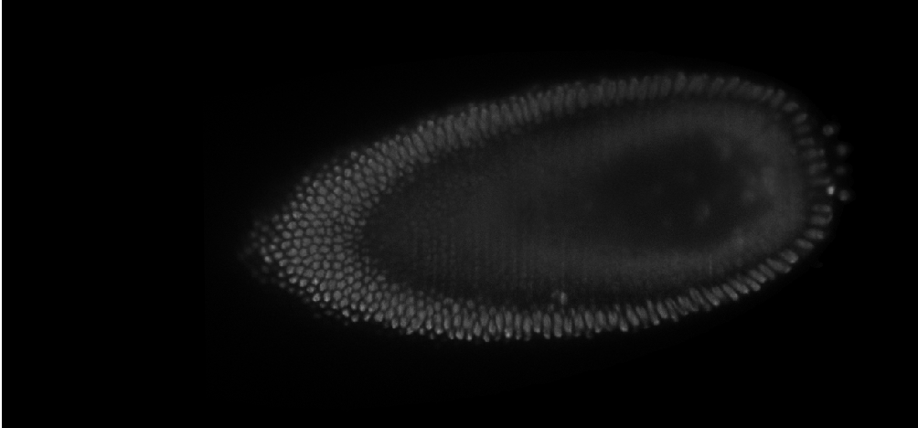
Exploratory Data Analysis: Nuclei
1
Data Science Lab 2018

Slide 10
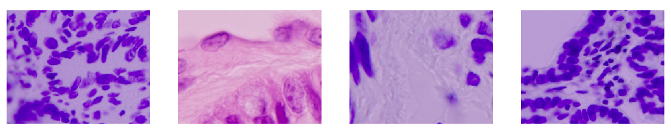
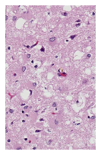
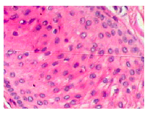
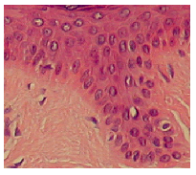
Stage 2 EDA : Images
1
Total 3019 images in the Stage 2 test data
Varied images when compared to Stage 1 test data.
Most of the images are Colored.
Data Science Lab 2018

Slide 11
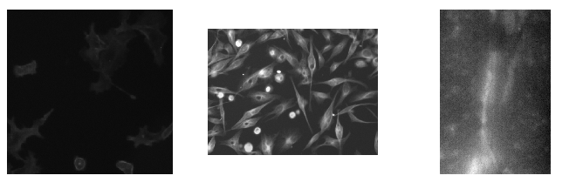
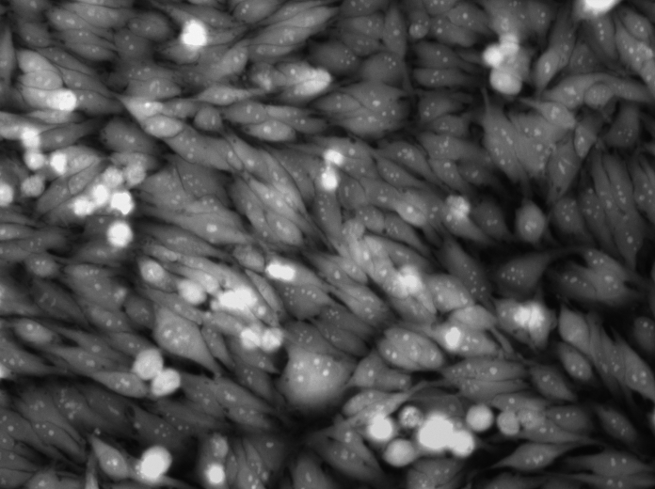
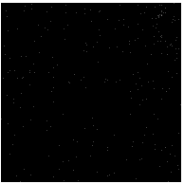
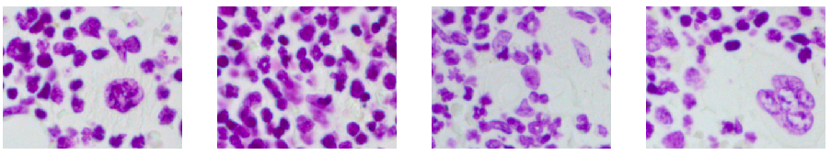
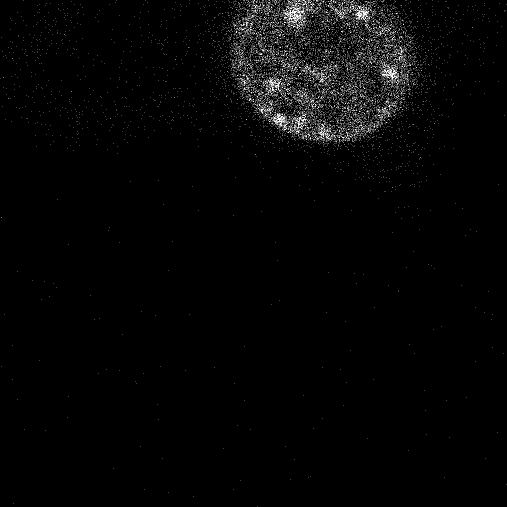
Stage 2 EDA : Images
1
Inference: Generalized Model is needed.
Data Science Lab 2018

Slide 12
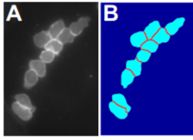
Our Approach
LOSS FUNCTIONS
POST PROCESSING
Multi Class weighted loss
Overlapping Objects Separation
Fill Binary Holes
Erosion/Dilation
Pre-Processing
Training
ENSEMBLING
U-Net
Pre-trained on COCO - Mask RCNN with resnet50 as backbone
Pre-trained on COCO - Mask RCNN with resnet101 as backbone
Ensemble results from test time augmentation.
Data Augmentation (Shift, Rotate, Flip, Zoom, Cropping, Invert Colors, Elastic Transformations)
Data Science Lab 2018
Notes:
Multiclass weighted loss: For instance segmentation of cluttered cells. Higher weights to alleviate the imbalance of classes in the training data and to emphasize cell contours, specially at touching borders, while maintaining lower weights for the abundant, more homogeneous, easily separable background pixels. However, it is also critical that background pixels around cell contours should carry proportionally higher weights as they help capturing cell borders more accurately specially in acute concave regions.
Resnet: Deep nueral networks need a lot of time and resources to train as more and more layers are added, which are needed to solve more complex problems.
In general, in a deep convolutional neural network, several layers are stacked and are trained to the task at hand. The network learns several low/mid/high level features at the end of its layers. In residual learning, instead of trying to learn some features, we try to learn some residuals, which can be simply understood as subtraction of feature learned from input of that layer. ResNet does this using shortcut connections (directly connecting input of nth layer to some (n+x)th layer.
https://arxiv.org/pdf/1512.03385.pdf
Test time augmentation: We predict class for the original test image along with a few random transforms of the same image. We then take an average of the predictions to determine which class the image belongs to.

Slide 13
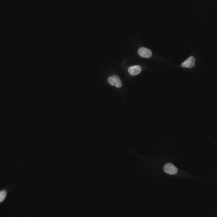
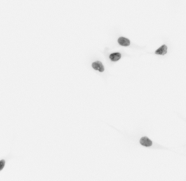
Pre Processing
Image augmentation artificially creates training images through different ways of processing or combination of multiple processing.
The transformations that we used:
Rotation: 90 and 180 degrees
Flip: left-right flip, up-down flip
Cropping: Random cropping of the image
Invert Colors: Turn darker colors to lighter ones and vice-versa
Original Image
Rotate right 90 degrees
Left-right flip
Invert Colors
Data Science Lab 2018
Notes:
Deep networks need large amount of training data to achieve good performance. To build a powerful image classifier using very little training data, image augmentation is usually required to boost the performance of deep networks. Image augmentation artificially creates training images through different ways of processing or combination of multiple processing, such as random rotation, shifts, shear and flips, etc.

Slide 14
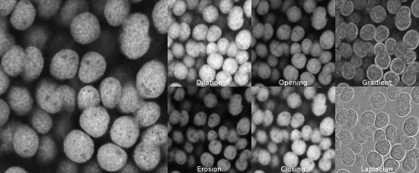
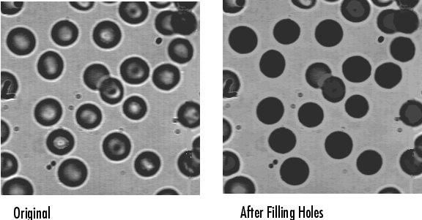
Post Processing
Overlapping Objects Separation
Filling binary holes: The masks should not have small gaps in them due to, say, reflections in the original image. This is combated by using this technique.
Erosion: Useful for removing small white noises and detaching two connected objects.
Dilation: Useful for joining broken parts of an object, usually follows erosion in cases of noise removal.
Data Science Lab 2018
Notes:
Overlapping Objects Separation
round objects doesn't have inset corners, if corners are present you can assume that this is overlapping scenario.
extract inset corners by subtract convex hull from object.
find all combinations of corners for separation candidate (some optimizations like crop, boundaries are used just for speed up).
separation line is valid if parallel line with offset 2 is shorter than offset 5 and if offset 5 is wider than separation line. This is checked in both directions.
Erosion: A pixel in the original image (either 1 or 0) will be considered 1 only if all the pixels under the kernel are 1, otherwise it is eroded (made to zero).
All the pixels near boundary will be discarded depending upon the size of kernel. So the thickness or size of the foreground object decreases or simply white region decreases in the image. It is useful for removing small white noises, detach two connected objects etc.
Dilation: A pixel element is ‘1’ if atleast one pixel under the kernel is ‘1’.It increases the white region in the image or size of foreground object increases. Normally, in cases like noise removal, erosion is followed by dilation. Because, erosion removes white noises, but it also shrinks our object. So we dilate it. Since noise is gone, they won’t come back, but our object area increases. It is also useful in joining broken parts of an object.
For erosion/dilation: https://docs.opencv.org/3.0-beta/doc/py_tutorials/py_imgproc/py_morphological_ops/py_morphological_ops.html

Slide 15

U-Net Architecture
1
Contracting Path Network:
Repeated Convolution Operation followed by a Relu Activation.
Max Pooling operation for down sampling.
Expanding Path Network:
Up Sampling of feature map followed by Up-Convolution.
Concatenation with the corresponding cropped feature map from contracting path.
Repeated Convolution Operation followed by a Relu Activation.
Data Science Lab 2018
Notes:
It consists of a Contracting Path followed by Expanding Path.
Each blue box is a multichannel feature web.
Convolution followed by a non linear activation function.
Downward operation is a Max pooling operation which operates on each channel separately. At each down sampling step we double the number of feature channels

Slide 16
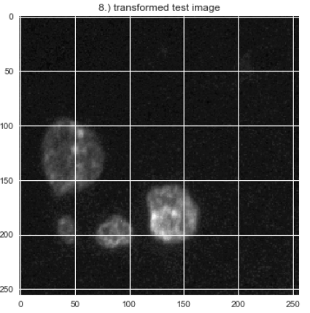
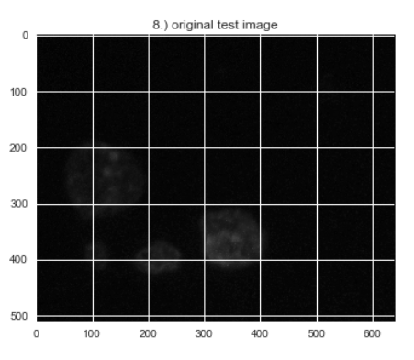
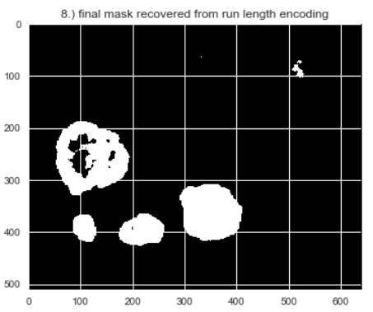

U-Net Implementation & Results
Trained U-Net on the images with basic pre-processing and all input images were transformed to dimension 256*256*3.
Learning Rate – 0.002, Droupout_prob =0.1
Rank – 860 ,IOU=0.35
Data Science Lab 2018

Slide 17
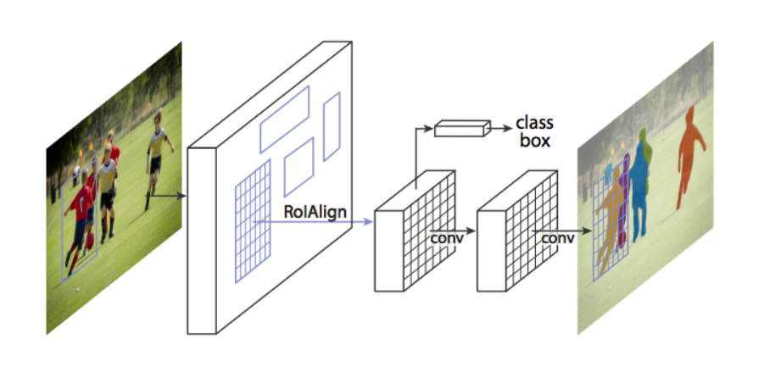
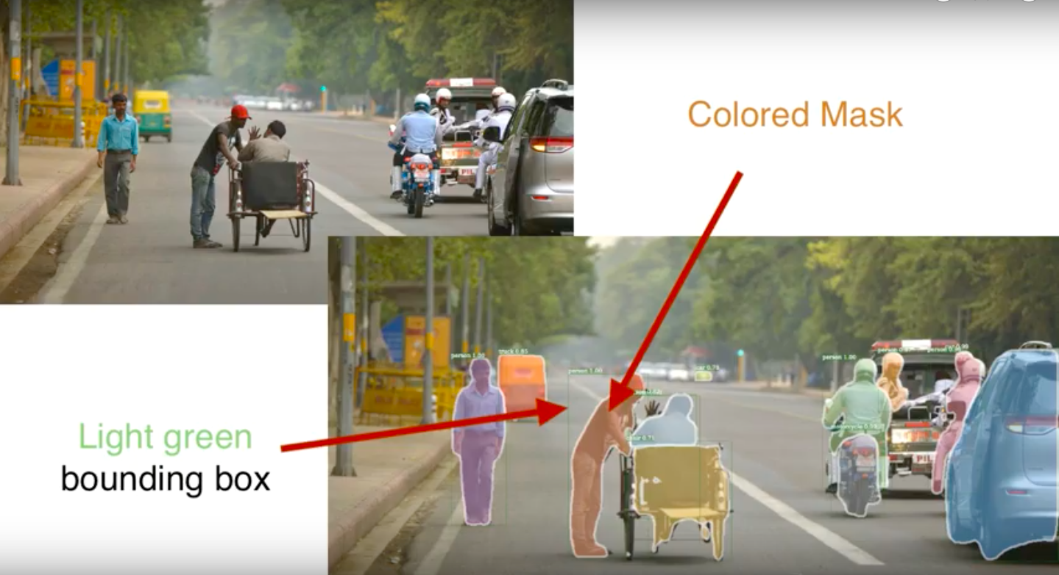
Masked Region-CNN Architecture
1
Final Result contains a bounding box obtained from
Object detection and and a colored mask from
Semantic Segmentation
Data Science Lab 2018

Slide 18
Masked RCNN Implementation & Results
We trained a Mask RCNN with COCO initialised weights and with the following configuration file.
LEARNING_RATE = 1e-5
BACKBONE = "resnet101"
MINI_MASK_SHAPE = (56, 56)
STEPS_PER_EPOCH = 300
VALIDATION_STEPS = 70
NUM_CLASSES = 1 + 1 # background + nucleis
IMAGE_MIN_DIM = 512
IMAGE_MAX_DIM = 512
IMAGE_PADDING = True
RPN_ANCHOR_SCALES = (8, 16, 32, 64, 128)
BACKBONE_STRIDES = [4, 8, 16, 32, 64]
# How many anchors per image to use for RPN training
RPN_TRAIN_ANCHORS_PER_IMAGE = 320
MEAN_PIXEL = np.array([0.,0.,0.])
# Weight decay regularization
WEIGHT_DECAY = 0.0002
# ROIs kept after non-maximum supression (training and inference)
POST_NMS_ROIS_TRAINING = 2000
POST_NMS_ROIS_INFERENCE = 2000
POOL_SIZE = 7
MASK_POOL_SIZE = 14
MASK_SHAPE = [28, 28]
TRAIN_ROIS_PER_IMAGE = 512
RPN_NMS_THRESHOLD = 0.7
MAX_GT_INSTANCES = 256
DETECTION_MAX_INSTANCES = 500
# Minimum probability value to accept a detected instance
# ROIs below this threshold are skipped
DETECTION_MIN_CONFIDENCE = 0.6
# Non-maximum suppression threshold for detection
DETECTION_NMS_THRESHOLD = 0.3
Data Science Lab 2018

Slide 19
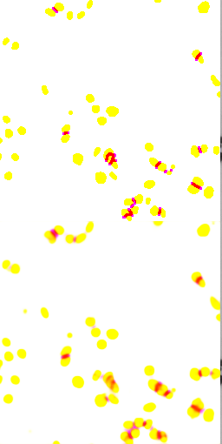
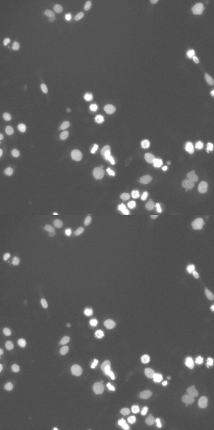
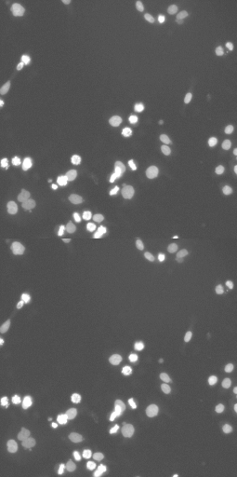
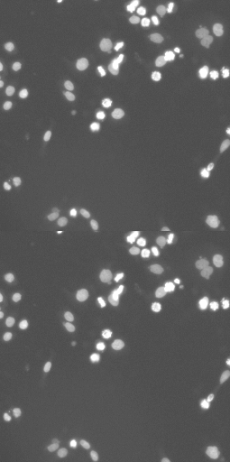
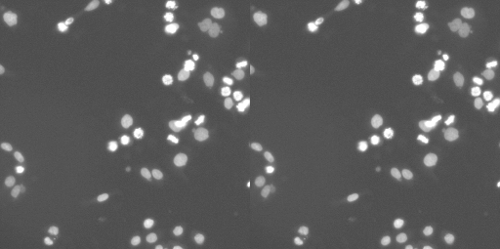
Masked RCNN Implementation & Results
Original Image
Flip LR
Flip UD
Rotate 90 degree
Data Science Lab 2018

Slide 20
Final Results
 | IOU | Public LB Ranking
UNET | 0.35 | 860
Mask RCNN Resnet50 | 0.42 | 431
Mask RCNN Resnet101 | 0.44 | 350
Mask RCNN 101 with Augmentation | 0.46 | 170
Mask RCNN 101 with Post Processing | 0.48 | 122
Our final Public LB Ranking was 122 but in stage 2 data set we could not check the score.
Final private LB ranking was 351(IOU=0.452) and Kaggle is reinstating the LB
Data Science Lab 2018

Slide 21
Top Rankers’ Solution
Some of the things that we didn’t try and provided good results to the top rankers.
Pre-Processing:
Implementation of Unet with lots of post processing.
Training on external datasets.
Adding Gaussian noise to images
Channel Shuffle
Backbone:
Resnet152 seemed to work better
Post-Processing:
Watershed
More TTA
Additional Dataset Use
Data Science Lab 2018

Slide 22
Conclusion
With this challenge we were able to learn how to handle the image data.
We learnt the training of models using transfer learning and implementation using different architectures.
The major learning was how overfitting of image data can harm the results and how we can avoid it using simpler architectures.
Data Science Lab 2018

Slide 23
THANK YOU
Data Science Lab 2018

Slide 24
References
Multi Class weighted loss
https://arxiv.org/pdf/1802.07465.pdf
Stacked U-Nets
https://arxiv.org/pdf/1803.04953.pdf
Erosion:
Erosion with small (e.g. 2×2 - 5×5) square structuring elements shrinks an image by stripping away a layer of pixels from both the inner and outer boundaries of regions. The holes and gaps between different regions become larger, and small details are eliminated:
Dilation:
Dilation has the opposite effect to erosion -- it adds a layer of pixels to both the inner and outer boundaries of regions.
Data Science Lab 2018

